Slide 1
Relational Algebra
11

Slide 2
Contents
Introduction to Relational algebra
Relational Algebra
Its operation

Slide 3
II. Derived Operations
Intersection (∩)
Division (÷)
Join (⋈)
Theta join
Natural join
Outer join
Left (⟕)
Right (⟖)
Full outer join (⟗)

Slide 4
I. Intersection Operator (∩)
Intersection operator is denoted by ∩ symbol and it is used to select common rows (tuples) from two tables (relations).
Lets say we have two relations R1 and R2 both have same columns and we want to select all those tuples(rows) that are present in both the relations, then in that case we can apply intersection operation on these two relations R1 ∩ R2.
Note: Only those rows that are present in both the tables will appear in the result set.
Syntax of Intersection Operator (∩)
table_name1 ∩ table_name2

Slide 5
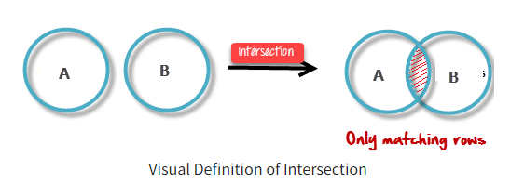
Intersection

Slide 6
Intersection
Table 1: COURSE Table 1: Student
Query: Output:
∏ Student_Name (COURSE) ∩ ∏ Student_Name (STUDENT)
Course_Id | Student_Name | Student_Id
C101 | Aditya | S901
C104 | Aditya | S901
C106 | Steve | S911
C109 | Paul | S921
C115 | Lucy | S931
Student_Id | Student_Name | Student_Age
S901 | Aditya | 19
S911 | Steve | 18
S921 | Paul | 19
S931 | Lucy | 17
S941 | Carl | 16
S951 | Rick | 18
Student_Name
Aditya
Steve
Paul
Lucy

Slide 7
Question
Consider two sets,
A={1,2,4,6} and B={1,2,7}
Intersection of A and B
A ∩ B ={1,2}
Elements that are present in both sets A and B are present in the set obtained by intersection of A and B.

Slide 8
II. Division
Division operator A÷B can be applied if and only if:
Attributes of B is proper subset of Attributes of A.
The relation returned by division operator will have attributes = (All attributes of A – All Attributes of B)
The relation returned by division operator will return those tuples from relation A which are associated to every B’s tuple.
The division operator is used for queries which involve the ‘all’.
R1 ÷ R2 = tuples of R1 associated with all tuples of R2.

Slide 9
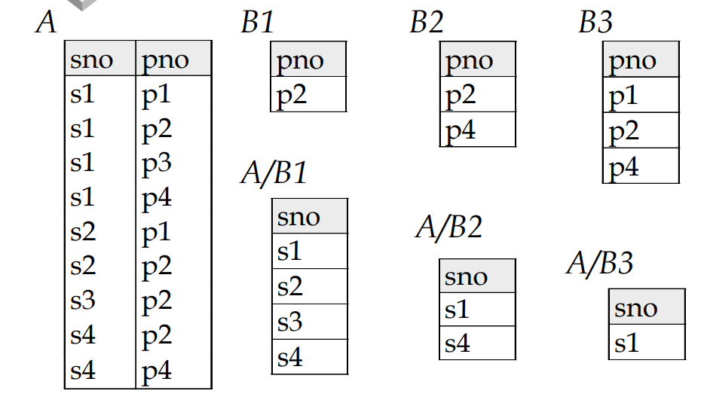
Example-Division

Slide 10
Question Time-Division
Retrieve the name of the subject that is taught in all courses
Table: R
Table: S
Name | Course
System | ECE
Database | B-CSE
Database | M-CSE
Maths | Applied
Table: R/S
Course
B-CSE
M-CSE
Name
Database

Slide 11
III. Join
A Join operation combines related tuples from different relations, if and only if a given join condition is satisfied. It is denoted by ⋈.
Table: Employee Table: Salary
Emp_code | Emp_Name
101 | Stephan
102 | Jack
103 | Harry
Emp_code | Salary
101 | 50000
102 | 30000
103 | 25000
Operation: (EMPLOYEE ⋈ SALARY)

Slide 12
Join
Output:
Emp_code | Emp_Name | Salary
101 | Stephan | 50000
102 | Jack | 30000
103 | Harry | 25000

Slide 13
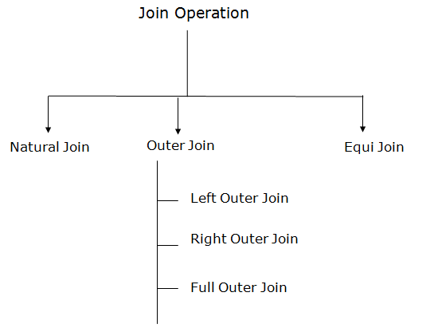
Types of Join operations:
Theta Join

Slide 14
1. Theta Join/ Non-equi Join
If we join R1 and R2 other than the equal condition, then it is called theta join/ non-equi join.
RegNo | Branch | Section
1 | CSE | A
2 | ECE | B
3 | CIVIL | A
4 | IT | B
5 | IT | A
RegNo | Branch | Section | Name | RegNo
1 | CSE | A | Bhanu | 2
1 | CSE | A | Priya | 4
2 | ECE | B | Bhanu | 2
2 | ECE | B | Priya | 4
3 | CIVIL | A | Bhanu | 2
3 | CIVIL | A | Priya | 4
4 | IT | B | Bhanu | 2
4 | IT | B | Priya | 4
Name | RegNo
Bhanu | 2
Priya | 4
In the join operation, we select those rows from the cartesian product where R1.regno>R2.regno.

Slide 15
1. Theta Join/ Non-equi Join
If we join R1 and R2 other than the equal condition, then it is called theta join/ non-equi join.
RegNo | Branch | Section
1 | CSE | A
2 | ECE | B
3 | CIVIL | A
4 | IT | B
5 | IT | A
RegNo | Branch | Section | Name | Regno
3 | CIVIL | A | Bhanu | 2
4 | IT | B | Bhanu | 2
5 | IT | A | Bhanu | 2
5 | IT | B | Priya | 4
Name | RegNo
Bhanu | 2
Priya | 4
In the join operation, we select those rows from the cartesian product where R1.regno>R2.regno.

Slide 16
II. Natural join/Equi Join
If we join R1 and R2 on equal condition then it is called natural join or equi join. Generally, join is referred to as natural join.
Natural join of R1 and R2 is as follows −
{we select those tuples from Cartesian product where R1.regno=R2.regno}
R1 ⋈ R2

Slide 17
II. Natural join/Equi Join
RegNo | Branch | Section | Name | RegNo
1 | CSE | A | Bhanu | 2
1 | CSE | A | Priya | 4
2 | ECE | B | Bhanu | 2
2 | ECE | B | Priya | 4
3 | CIVIL | A | Bhanu | 2
3 | CIVIL | A | Priya | 4
4 | IT | B | Bhanu | 2
4 | IT | B | Priya | 4
Regno | Branch | Section | Name
2 | ECE | B | Bhanu
4 | IT | B | Priya
R1 ⋈ R2
R1 X R2

Slide 18
Natural Join-Example
A Join operation combines related tuples from different relations, if and only if a given join condition is satisfied. It is denoted by ⋈.
Table: Employee Table: Salary
Emp_code | Emp_Name
101 | Stephan
102 | Jack
103 | Harry
Emp_code | Salary
101 | 50000
102 | 30000
103 | 25000
Operation: (EMPLOYEE ⋈ SALARY)

Slide 19
Natural Join-Example
Output:
Emp_Name | Salary
Stephan | 50000
Jack | 30000
Harry | 25000
∏EMP_NAME, SALARY (EMPLOYEE ⋈ SALARY)

Slide 20
III. Outer Join
The outer join operation is an extension of the join operation. It is used to deal with missing information.
EMPLOYEE
FACT_WORKERS
EMP_NAME | STREET | CITY
Ram | Civil line | Mumbai
Shyam | Park street | Kolkata
Ravi | M.G. Street | Delhi
Hari | Nehru nagar | Hyderabad
EMP_NAME | BRANCH | SALARY
Ram | Infosys | 10000
Shyam | Wipro | 20000
Kuber | HCL | 30000
Hari | TCS | 50000

Slide 21
Outer Join
EMP_NAME | STREET | CITY | BRANCH | SALARY
Ram | Civil line | Mumbai | Infosys | 10000
Shyam | Park street | Kolkata | Wipro | 20000
Hari | Nehru nagar | Hyderabad | TCS | 50000
(EMPLOYEE ⋈ FACT_WORKERS)

Slide 22
A. Left outer join
Left outer join contains the set of tuples of all combinations in R and S that are equal on their common attribute names.
In the left outer join, tuples in R have no matching tuples in S.
It is denoted by ⟕.

Slide 23
Left outer join-Example
EMP_NAME | STREET | CITY | BRANCH | SALARY
Ram | Civil line | Mumbai | Infosys | 10000
Shyam | Park street | Kolkata | Wipro | 20000
Hari | Nehru street | Hyderabad | TCS | 50000
Ravi | M.G. Street | Delhi | NULL | NULL
Example: Using the above EMPLOYEE table and FACT_WORKERS table
Input:
EMPLOYEE ⟕ FACT_WORKERS

Slide 24
B. Right Outer Join
Right outer join contains the set of tuples of all combinations in R and S that are equal on their common attribute names.
In right outer join, tuples in S have no matching tuples in R.
It is denoted by ⟖.

Slide 25
Right Outer Join
EMP_NAME | BRANCH | SALARY | STREET | CITY
Ram | Infosys | 10000 | Civil line | Mumbai
Shyam | Wipro | 20000 | Park street | Kolkata
Hari | TCS | 50000 | Nehru street | Hyderabad
Kuber | HCL | 30000 | NULL | NULL
Example: Using the above EMPLOYEE table and FACT_WORKERS Relation
Input:
EMPLOYEE ⟖ FACT_WORKERS

Slide 26
C. Full Join
Full outer join is like a left or right join except that it contains all rows from both tables.
In full outer join, tuples in R that have no matching tuples in S and tuples in S that have no matching tuples in R in their common attribute name.
It is denoted by ⟗.

Slide 27
Full Outer Join-Example
EMP_NAME | STREET | CITY | BRANCH | SALARY
Ram | Civil line | Mumbai | Infosys | 10000
Shyam | Park street | Kolkata | Wipro | 20000
Hari | Nehru street | Hyderabad | TCS | 50000
Ravi | M.G. Street | Delhi | NULL | NULL
Kuber | NULL | NULL | HCL | 30000
Example: Using the above EMPLOYEE table and FACT_WORKERS table
Input: EMPLOYEE ⟗ FACT_WORKERS

Slide 28


